Slide 1
Insurance Data Analysis
Group Members
Ritesh Gaikwad
Amol valmiki Kamble
Nitin Deshmukh
Kunal Prabhakar Gurav
Soumit Mitra
Ashmika K.V
Ashwini R

Slide 2
Index
SR.NO | SLIDES
1 | Introduction
2 | Data Source & Tools
3 | KPI Analysis
4 | Dashboard Overview
5 | SQL Implementation
6 | Conclusion & Suggestions
7 | Challenges & Learnings

Slide 3
Introduction
Objective:
Analyze insurance data.
Identify trends & performance.
Tool Used:
MySQL → Data storage & querying
Power BI → Dashboard
Tableau → Visualization
Excel → Data cleaning.

Slide 4



Key Performance Indicator Slides
KPI 1: Total Policies
Insight: Business scale
Observation: 3000 policies.
KPI 2: Total Customers
Insight: Customer base size
Observation: 5000 customers.
KPI 3: Expiring Policies
Insight: Renewal opportunity
Observation: 453 policies expiring

Slide 5
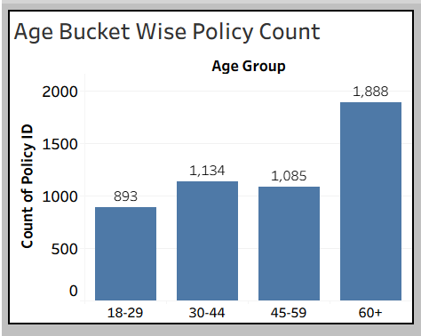
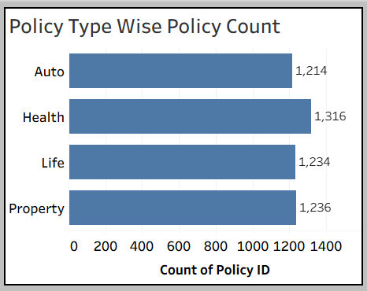
KPI
KPI 4: Age Bucket
Insight: 60+ dominates
Observation: Older customers buy more policies.
KPI 5: Policy Type
Insight: Health highest
Observation: Most preferred policy.

Slide 6
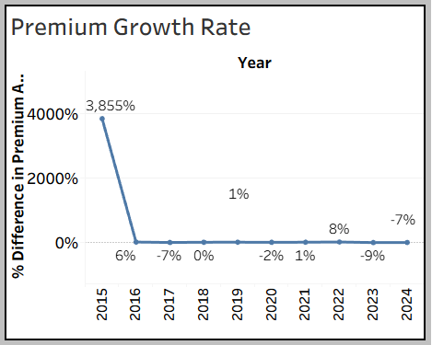
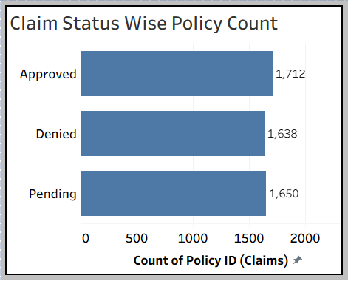
KPI
KPI 6: Premium Growth
Insight: Business growth trend
Observation: Spike initially then stable growth.
KPI 7: Claim Status
Insight: Approval rate
Observation: Most claims approved.

Slide 7
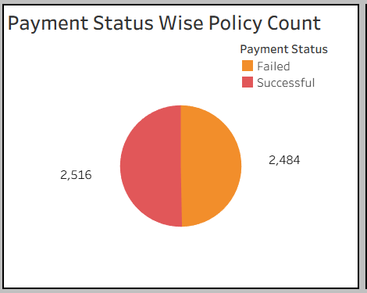
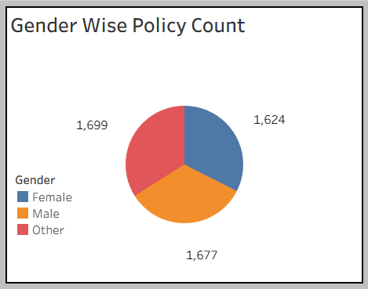
KPI
KPI 8: Payment Status
Insight: Payment success rate
Observation: Nearly equal split.
KPI 9: Gender
Insight: Balanced distribution
Observation: Slight variation across genders.

Slide 8

KPI
KPI 10: Total Claim Amount
Insight: Financial impact
Observation: 251.4M claims.

Slide 9
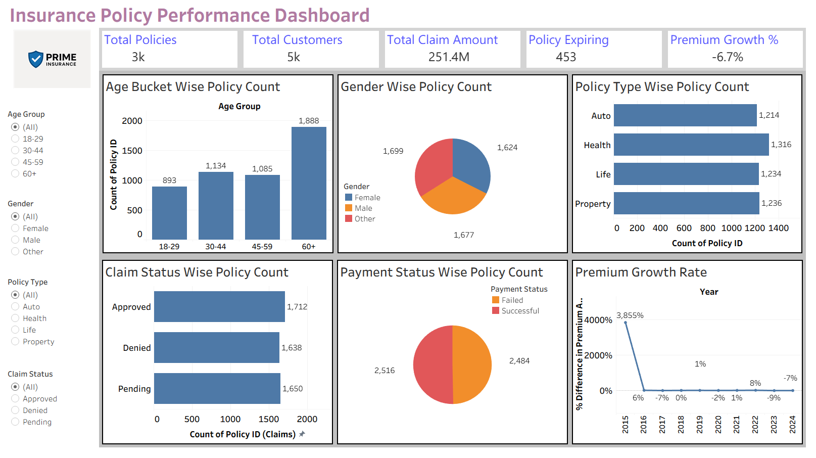
Dashboard Overview

Slide 10
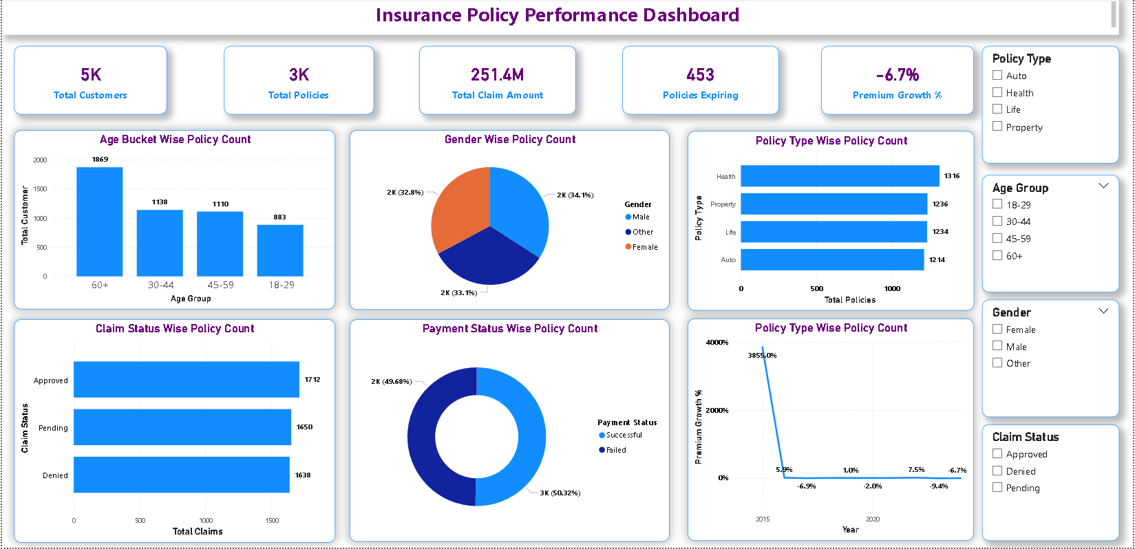
Dashboard Overview

Slide 11
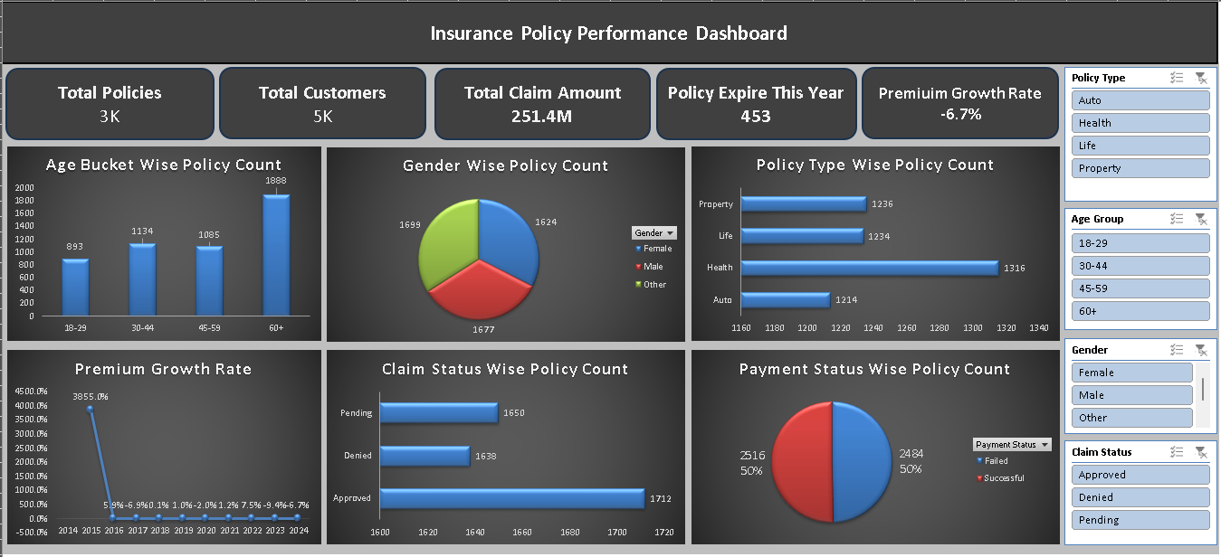
Dashboard Overview

Slide 12
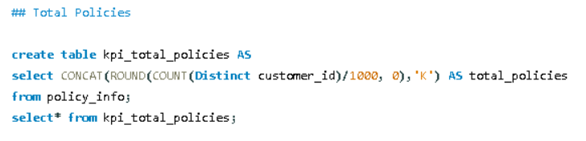
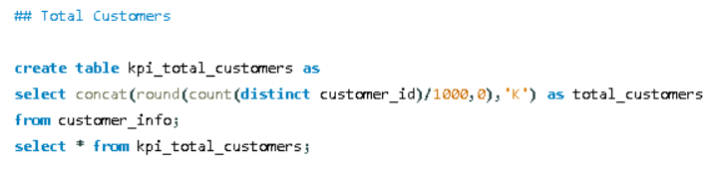
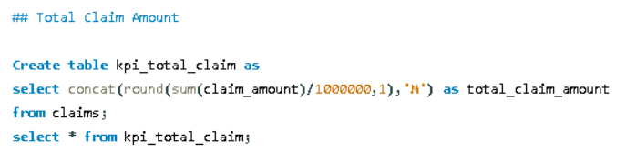
SQL Implementation

Slide 13
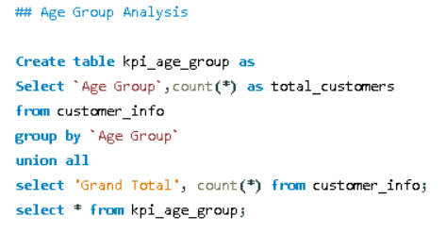
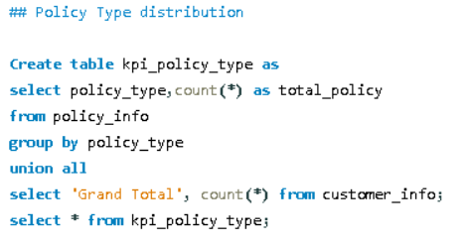
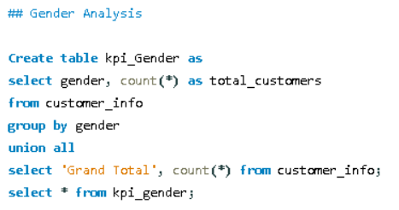
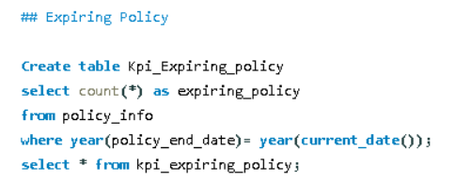
SQL Implementation

Slide 14
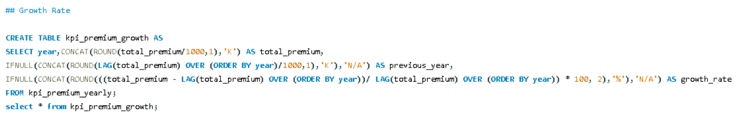
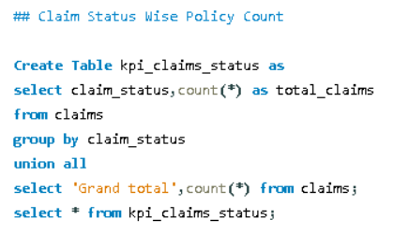
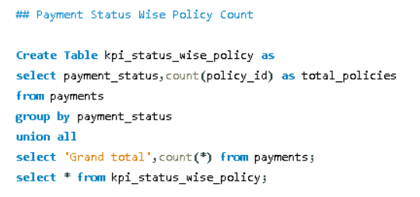
SQL Implementation

Slide 15
Conclusion & Suggestions
Conclusion
Business is growing steadily
Health policies are most popular
High claim approval rate
Renewal opportunities exist.
Suggestions
Focus on younger age groups
Improve payment success rate
Promote high-performing policies
Optimize claim process.

Slide 16
Challenges & Learnings
Challenges
Data cleaning issues
Date format errors in MySQL
Incorrect KPI calculations
Tableau formatting issues.
Overcome Challenge
Handled NULL values
Used aggregation functions correctly
Fixed visualization using proper dimensions

